Slide 1
First Aid for Tenderfoot, 2nd Class, and 1st Class
BSA Troop 344/9344
Pemberville, OH

Slide 2
What is First Aid?
First Aid: is the provision of limited care for an illness or injury, which is provided, usually by a lay person, to a sick or injured patient until definitive medical treatment can be accessed, or until the illness or injury is dealt with (as not all illnesses or injuries will require a higher level of treatment). It generally consists of series of simple, sometimes life saving, medical techniques, that an individual, either with or without formal medical training, can be trained to perform with minimal equipment.

Slide 3

Tenderfoot First Aid
Requirements
4a. Show first aid for the following:
  Simple cuts and scrapes.
  Blisters on the hand and foot.
  Minor (thermal/heat) burns or scalds (superficial, or first degree)
  Bites or stings of insects or ticks.
  Venomous snakebite.
  Nosebleed.
  Frostbite and sunburn.
  Choking.
4b. Describe common poisonous or hazardous plants; identify any that grow in your local area or campsite location. Tell how to treat for exposure to them.
4c. Tell what you can do while on a campout or other outdoor activity to prevent or reduce the occurrence of injuries or exposure listed in Tenderfoot requirements 4a and 4b.
4d. Assemble a personal first-aid kit to carry with you on future campouts and hikes. Tell how each item in the kit would be used.

Slide 4
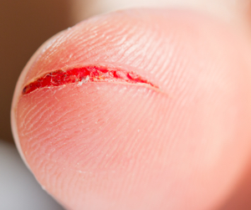
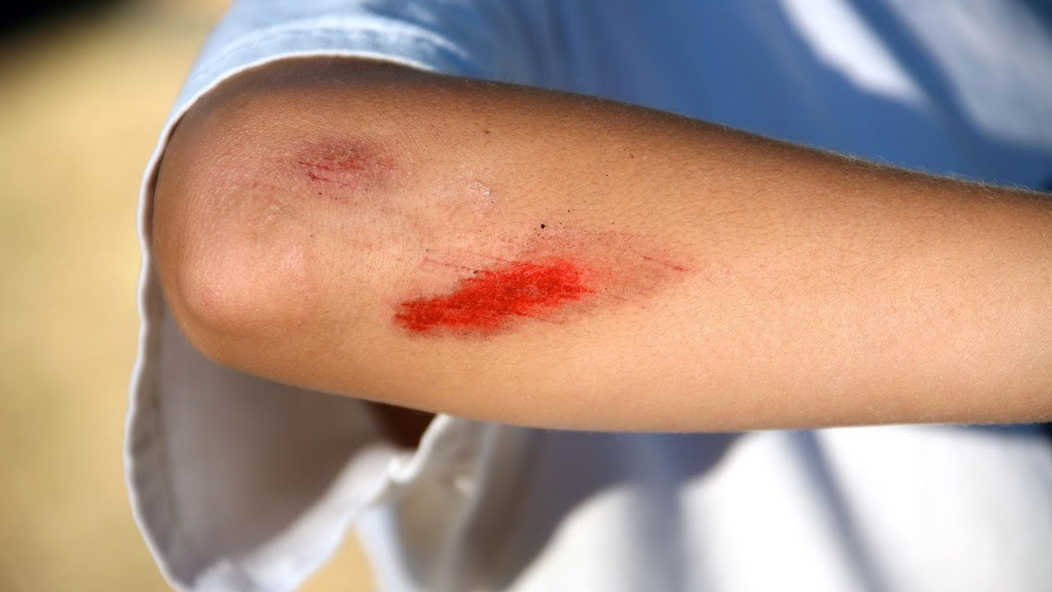
Simple Cuts and Scratches
Simple cuts are skin injuries caused by sharp objects.
  Usually not very deep
Scratches are areas of damage to the upper layers of skin.

Slide 5
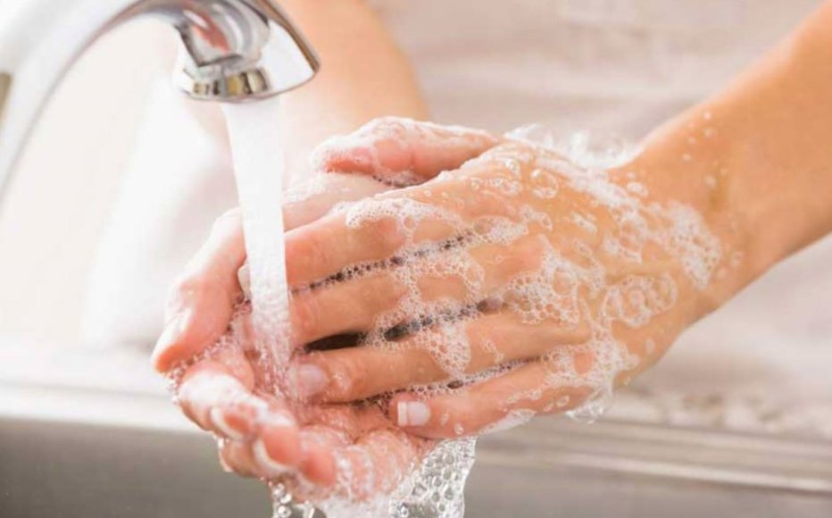
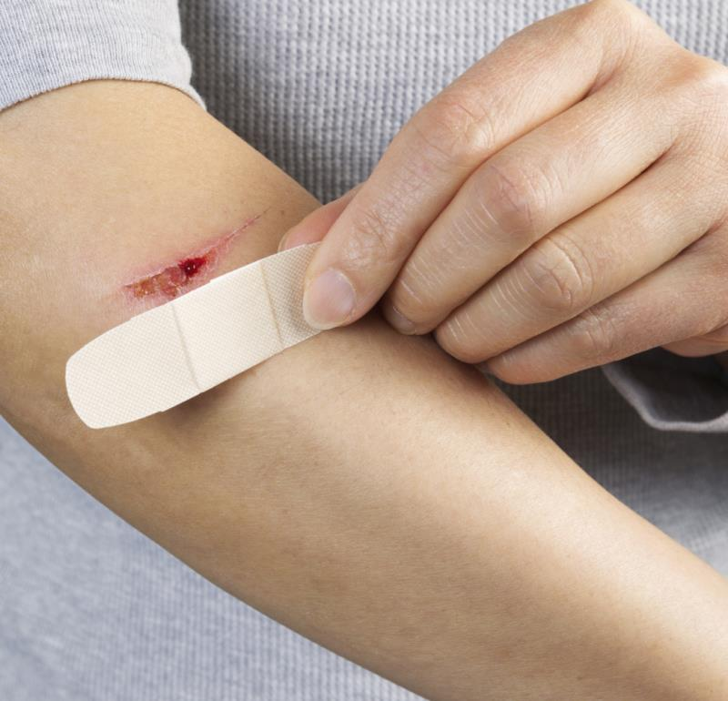
Treatment for Cuts and Scratches
Wash the wound with soap and water for 5 minutes.
  Remove any bits of dirt, small pieces of rock, or other debris.
Apply an antibiotic ointment such as Neosporin and cover it with a Band-Aid or gauze.

Slide 6
Common Mistakes in Treating Cuts and Scratches
  Don't use alcohol or Merthiolate on open wounds. They sting and damage normal tissue.
  Don't kiss an open wound because the wound will become contaminated by the many germs in a person's mouth. No kissing the Boo Boo!
  Let the scab fall off by itself; picking it off may cause a scar.

Slide 7
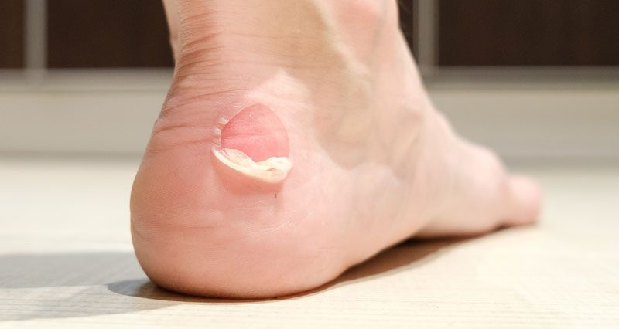
Blisters
A blister is skin injury that is usually filled with water.
Blisters commonly occur on the feet or hands.
They are most often caused by the hands or feet rubbing against something (such as wearing new shoes).

Slide 8
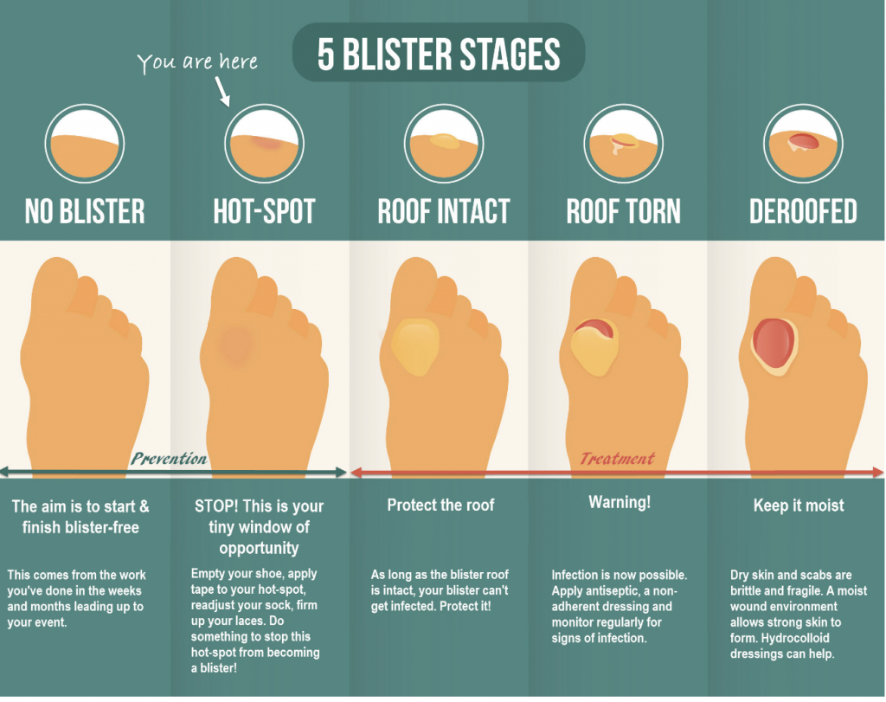

Slide 9
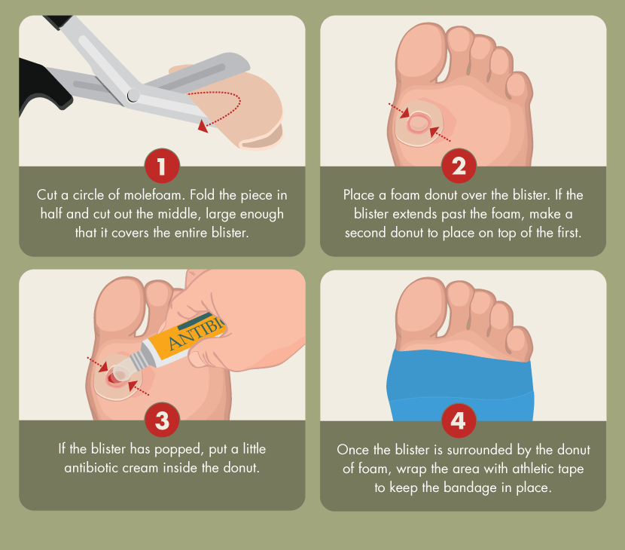
Treatment for
Blisters
Do not open the blisters, since this increases the possibility of infection.
Clean the skin around it.
Take the pressure off the area by placing a Band-Aid over the blister or Moleskin with a hole cut in the center.
If the blister accidentally breaks open, trim off the loose skin.
Keep the surface clean by washing it twice a day with an antibacterial soap (such as Dial or Safeguard).
Apply an antibiotic ointment and a Band-Aid to help with healing.

Slide 10
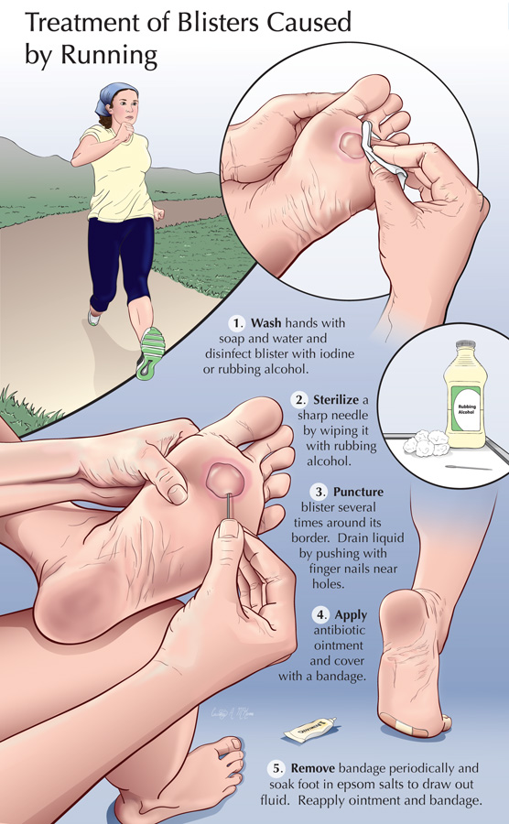
Popping a Blister
If a blister is in a frequently used area that has a high risk of rupturing, it may be best to pop it to make sure it’s properly protected against infection.
Wash your hands and the blister thoroughly.
Disinfect a needle with alcohol.
Carefully puncture the blister.
  Poke three or four shallow holes around the edge of the blister.
  You want to keep as much of the skin intact as possible.
  Allow the fluid to drain out.
Cover the blister with a first aid ointment such as Neosporin.
Apply a dressing.
  Cover the blister tightly with a bandage or gauze.
Repeat if necessary.
  You may need to perform these steps every six to eight hours for the first 24 hours.
  After that, change the dressing and apply ointment daily.

Slide 11
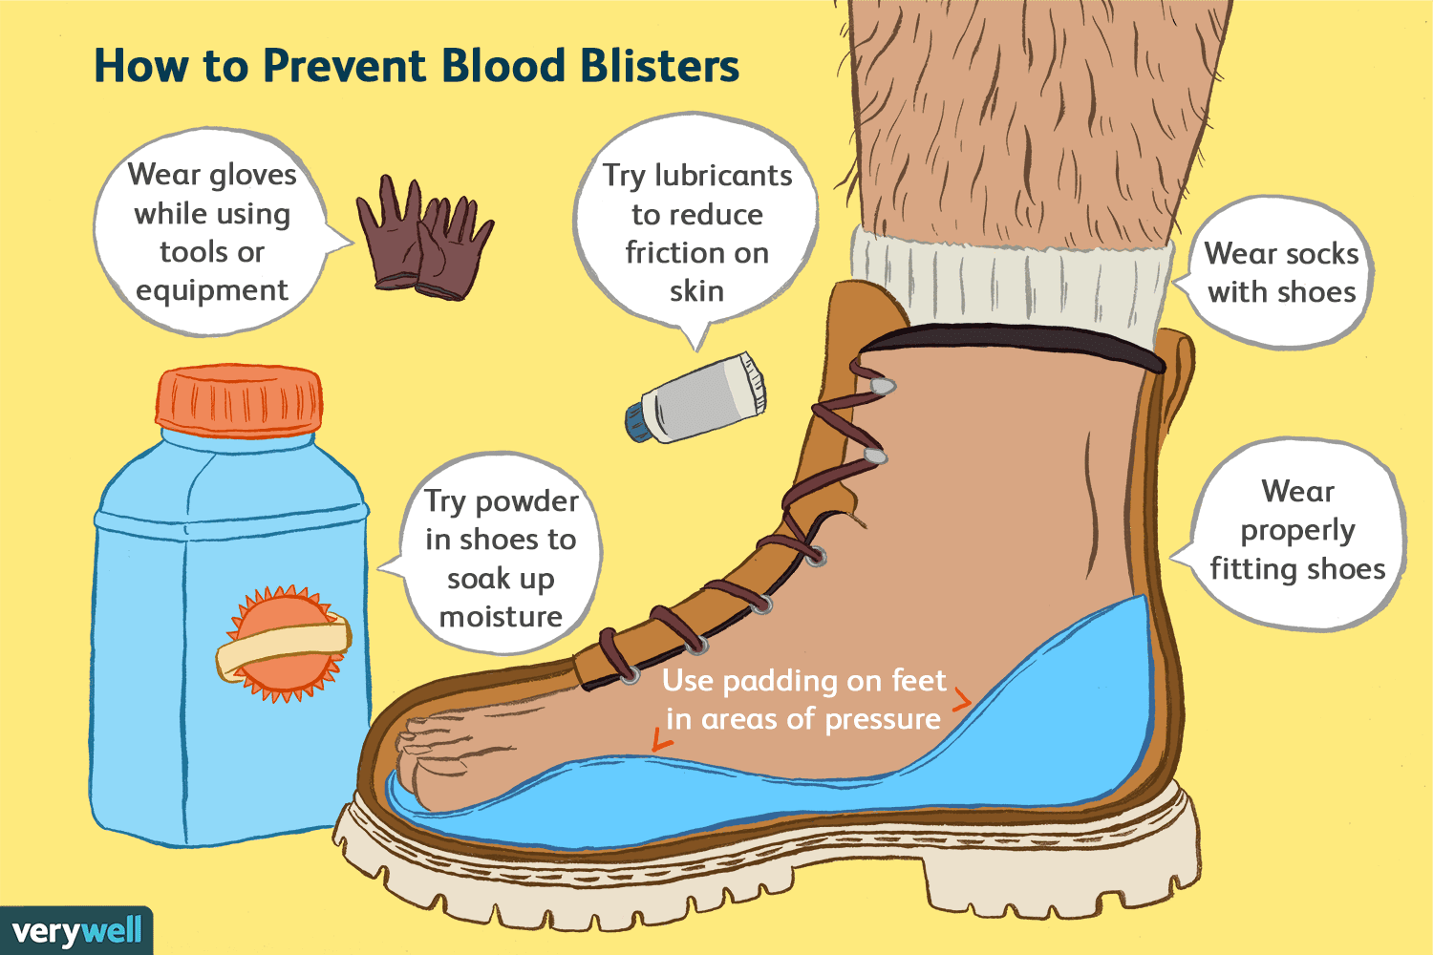
Preventing Blisters
Friction can also be reduced by wearing two pairs of socks.
Place Moleskin on sensitive areas were the friction may occur.

Slide 12
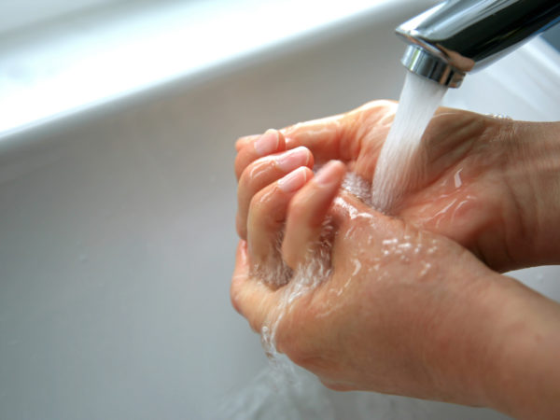
Minor burns/scalds (1st degree)
A first degree burn is reddened skin without blisters.
Immediately put the burned part in cold tap water for 10 minutes.
This will lessen the depth of the burn and relieve pain.

Slide 13
Insect Bites
Bites of mosquitoes, chiggers (harvest mites), fleas, and bedbugs usually cause itchy, red bumps. The size of the swelling can vary from a dot to a half inch.
Signs that a bite is from a mosquito are: itchiness, a central raised dot in the swelling, a bite on skin not covered by clothing, and summertime,
Fleas and bedbugs tend to bite skin under clothing. Flea bites often turn into little blisters in young children.
Bites from horseflies, deerflies, gnats, fire ants, harvester ants, blister beetles, and centipedes usually cause a painful, red bump. Fire ant bites change to blisters or pimples within a few hours.

Slide 14
Treatment of Insect Bites
Apply calamine lotion or a baking soda paste to the area of the bite.
If the itch is severe (as with chiggers), apply nonprescription 1% hydrocortisone cream four times a day.
Do not to pick at the bites or they can become infected or leave scars.
Cold, moist compresses or ice on the area can help.

Slide 15
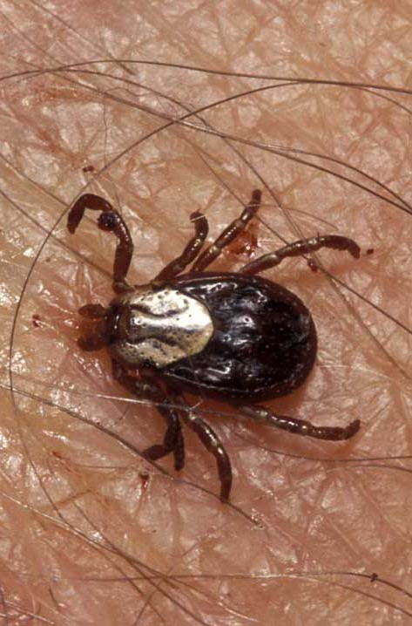
Tick Bites
Can transmit Rocky Mountain spotted fever or Lyme disease
Tick embeds it’s mouth parts in skin and may remain for days sucking blood.

Slide 16
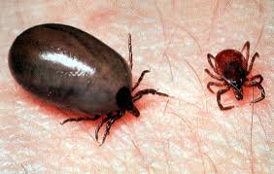
Engorged Tick

Slide 17
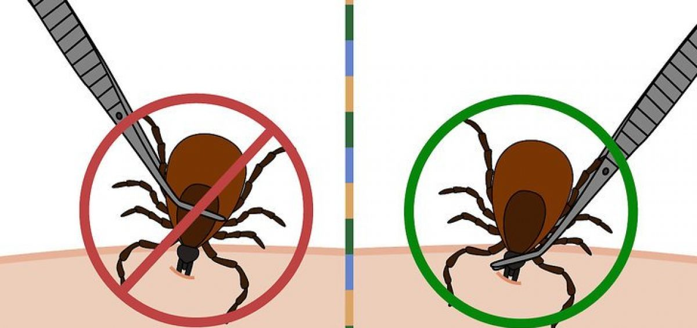
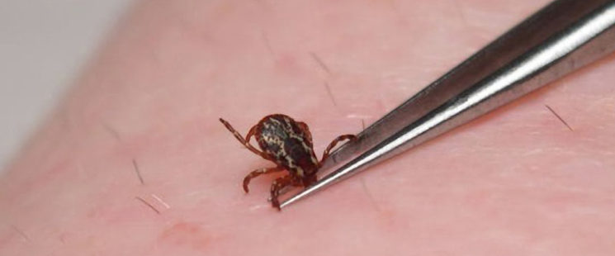
Tick Removal
Grasp the tick’s mouthparts against the skin, using pointed tweezers.
Pull steadily without twisting until you can ease the tick head straight out of the skin.
DO NOT squeeze or crush the body of the tick.
DO NOT apply substances such as petroleum jelly, nail polish, or a lighted match to the tick while it is attached.

Slide 18
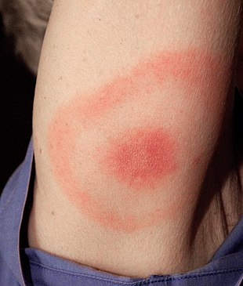
Tick Removal Cont.
Once you have removed the tick, wash the wound site and your hands with soap and water, and apply rubbing alcohol or antiseptic to the site.
Observe the bite over the next two weeks for any signs of an expanding red rash or flu-like symptoms (Lyme Disease).
Lyme Disease Rash

Slide 19
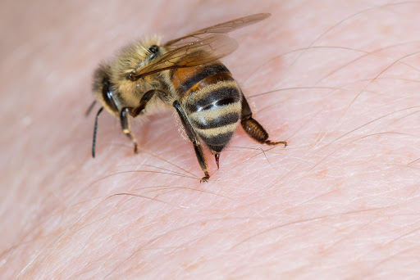
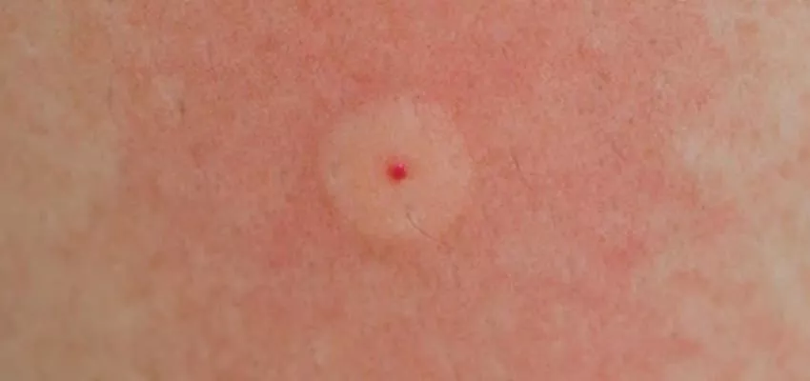
Bee Stings
Honey bees, bumble bees, hornets, wasps, and yellow jackets can all sting.
These stings cause immediate painful red bumps.
While the pain is usually better in 2 hours, the swelling may increase for up to 24 hours.

Slide 20
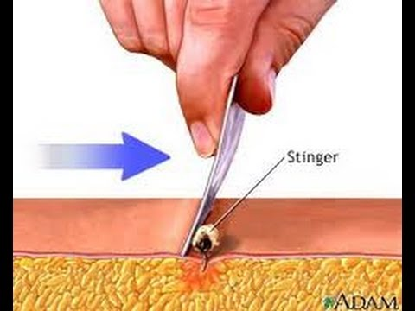
Treatment of stings
If you see a little black dot in the bite, the stinger is still present (this only occurs with honey bee stings).
Remove it by scraping it off with a credit card or something similar.
For persistent pain, massage with an ice cube for 10 minutes.
Give acetaminophen immediately for relief of pain and burning.
For itching, apply hydrocortisone cream.

Slide 21
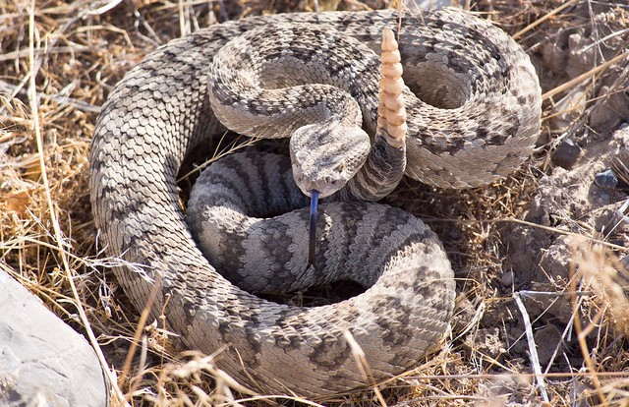
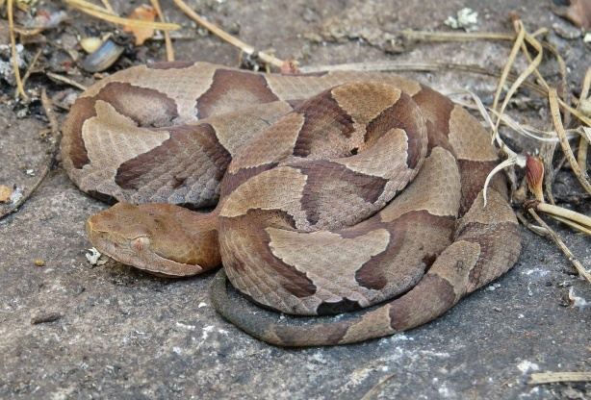
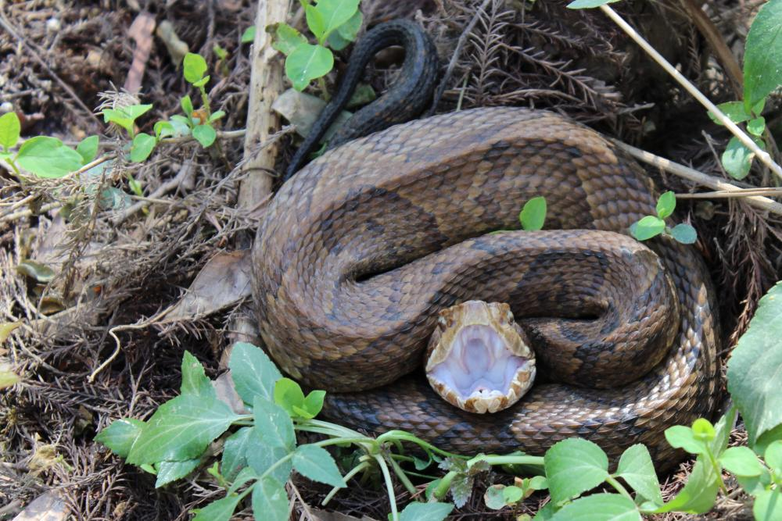
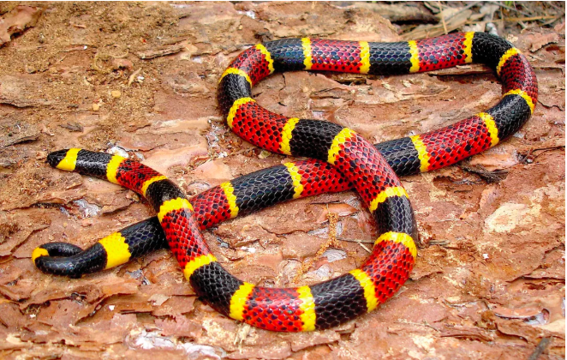
Poisonous Snakebite
In the U.S. the poisonous snakes are rattlesnakes, copperheads, cottonmouths, and coral snakes.
Currently about 8,000 people per year in the U.S. are bitten by a poisonous snake, of which about 6 will die.

Slide 22
First Aid for Poisonous Snake Bites
Have victim lie down and stay calm.
Keep bitten area immobile and below level of heart.
Call 911.
Wash bite wound with soap and water.
Remove jewelry or tight clothing before swelling.
Do not try to catch snake but note appearance.
If possible, wrap entire extremity with elastic (compression) bandage to slow spread of venom.
Do not use a tourniquet.
Do not cut wound open to try to drain or suck venom out.

Slide 23
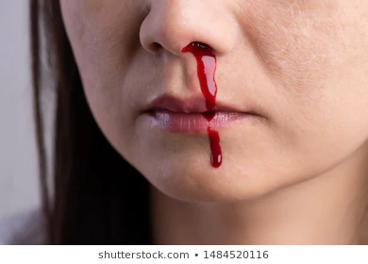
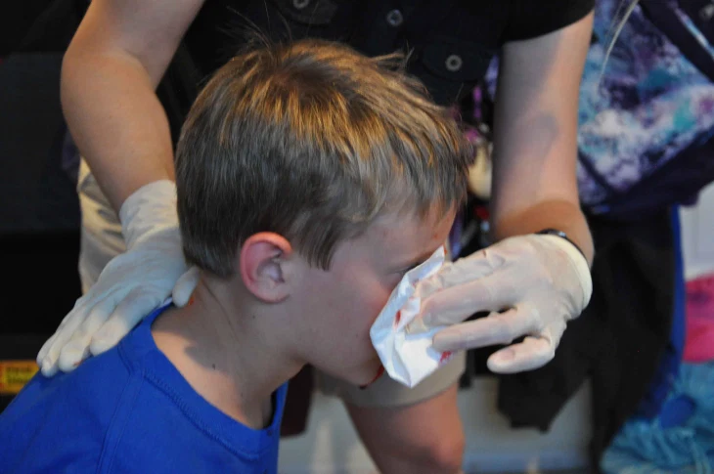
Nosebleed
Sit the person down with head held forward.
Do not let their head tip back – blood will run down throat.
Pinch the nose firmly just below the bridge.
After ten minutes, gently release the pressure.
If there is still bleeding, reapply the pressure for further periods of ten minutes.

Slide 24
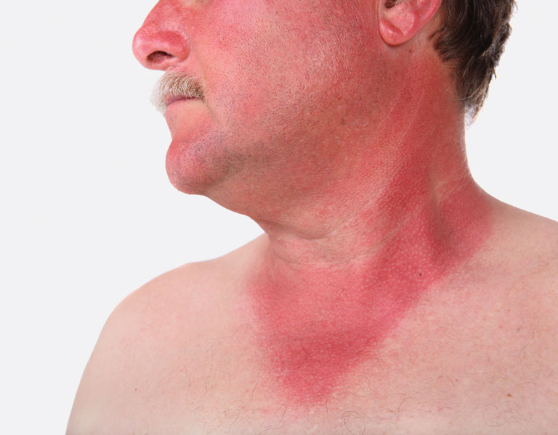
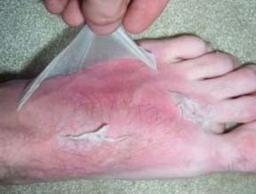
Sunburns
Severe sunburn can be a significant first aid situation.
Sunburn is preventable with protective ointments, clothing, or staying out of the sun.
Long term effects of sunburn has been linked to skin cancers.

Slide 25
Sunburns
Symptoms:
  Redness.
  Minor inflammation, or swelling.
  Pain.
  Dry, peeling skin occurs as the burn heals.
Treatment:
  Soak the wound in cool water for five minutes or longer.
  Take acetaminophen or ibuprofen for pain relief.
  Apply lidocaine (an anesthetic) with Aloe Vera to soothe the skin.
  Use an antibiotic ointment and loose gauze to protect the affected area.
  Make sure you don’t use ice, as this may make the damage worse.

Slide 26
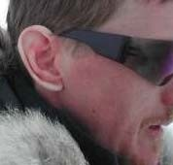
Frost Nip
Frost nip is an earlier and milder case of frostbite. Usually the ears, cheeks, nose, fingers and toes are affected.
Skin white or numb.
Don’t rub – hold against a warm body part.
Change clothing and/or environment.
Frost nip is a warning that you are not keeping warm enough!

Slide 27
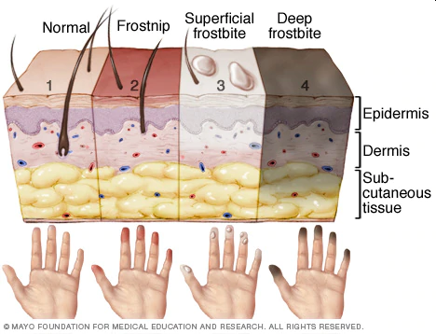
Frostbite
Mild Frostbite:
  Skin looks waxy and white, gray, yellow, or bluish.
  Area is numb or feels tingly or aching
Severe Frostbite:
  Area feels hard.
  May become painless
  After warming, area becomes swollen and may blister.

Slide 28
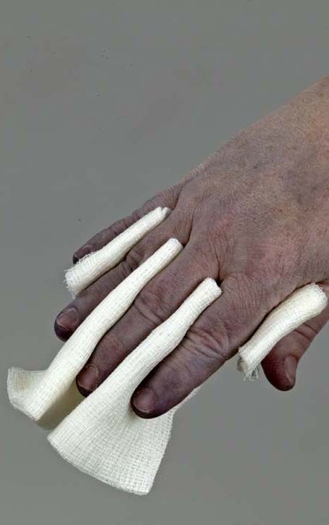
First Aid for Frostbite
Move victim to warm environment.
Hold frostbitten area in hands to warm – do not rub.
Remove any tight clothing or jewelry around area.
Put dry gauze or fluffy cloth between frostbitten fingers or toes.
Do not use heat lamp, campfire, or heating pad to rewarm.
Seek medical attention immediately.

Slide 29
Prevention of Frostbite
Be sure you dress in layers for cold weather. The first layer should be thermal underwear, and the outer layer needs to be waterproof. The layers should be loose, not tight. Mittens are warmer than gloves.
You should wear a hat. Over 50% of a your body heat is lost from the head.
Set limits on the time spent outdoors when the wind-chill temperature falls below 0°F (-18°C).
Recognize the earliest warnings of frostbite. Tingling and numbness are reminders that your are not dressed warmly enough for the weather and needs to go indoors.

Slide 30
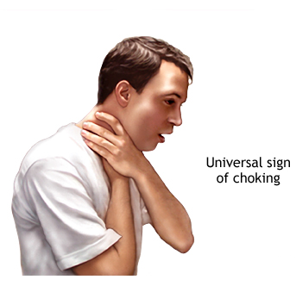
Identifying someone choking.
If an adult or child is choking, you may observe the following behaviors:
  Coughing, wheezing, or gagging
  Hand signals and panic (sometimes pointing to the throat)
  Sudden inability to talk
  Clutching the throat: The natural response to choking is to grab the throat with one or both hands. This is the universal choking sign and a way of telling people around you that you are choking.
  Passing out
  A blue coloring to the skin, can be seen earliest around the face, lips, and fingernail beds.

Slide 31
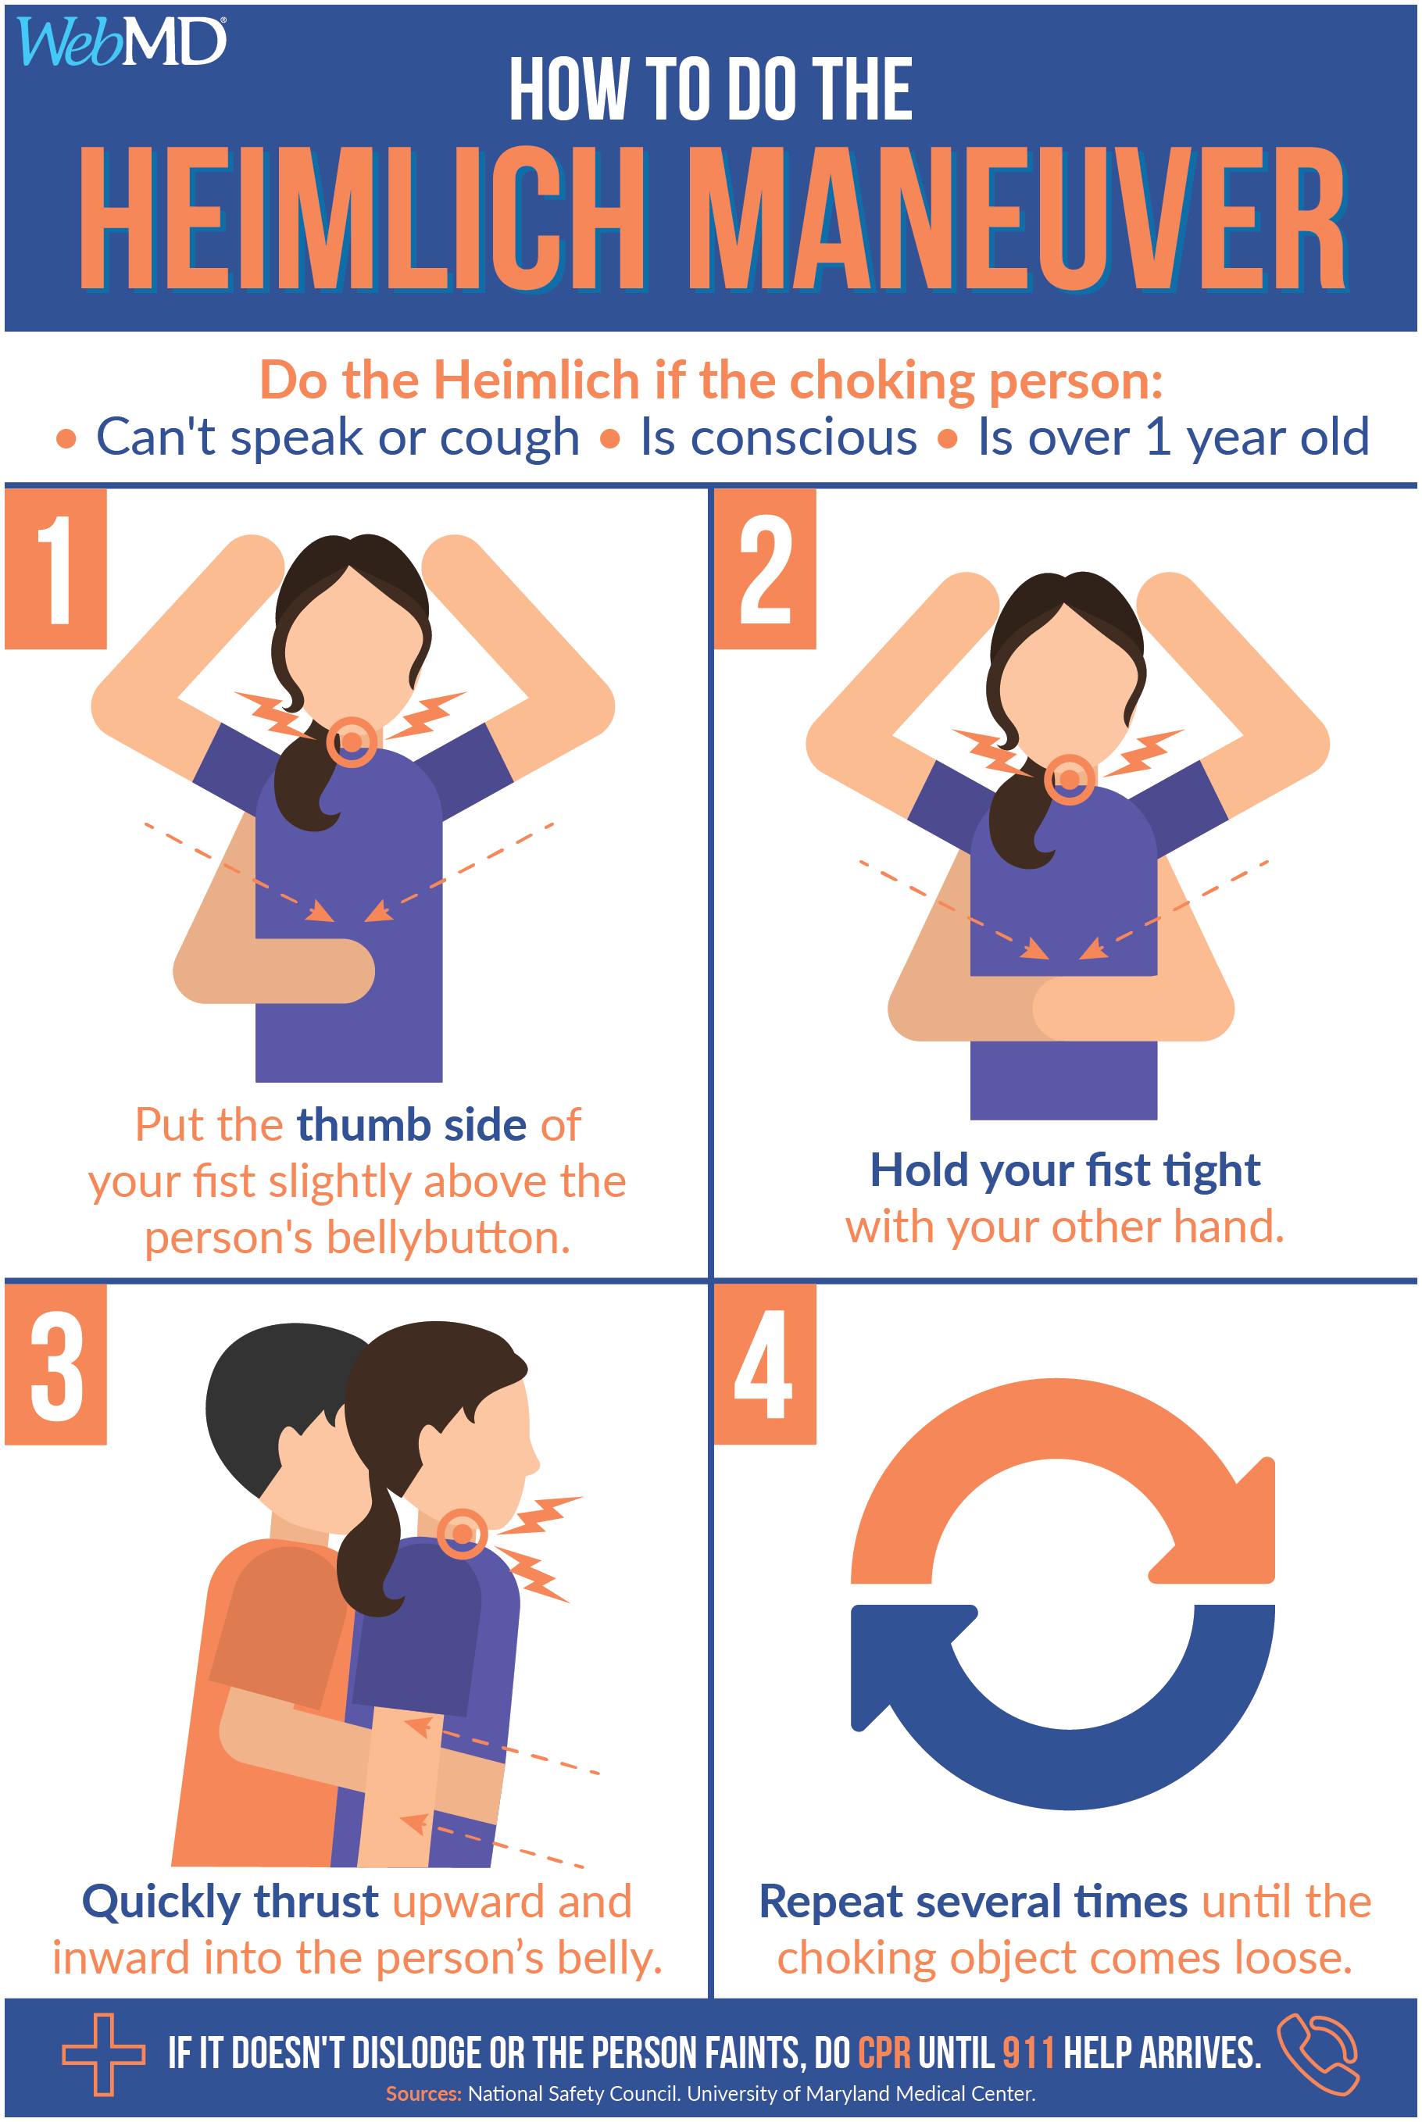
Choking First Aid
Call 911.
Administer the Heimlich Maneuver

Slide 32
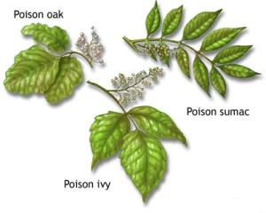
Poisonous Plants
Can you identify and name them?

Slide 33
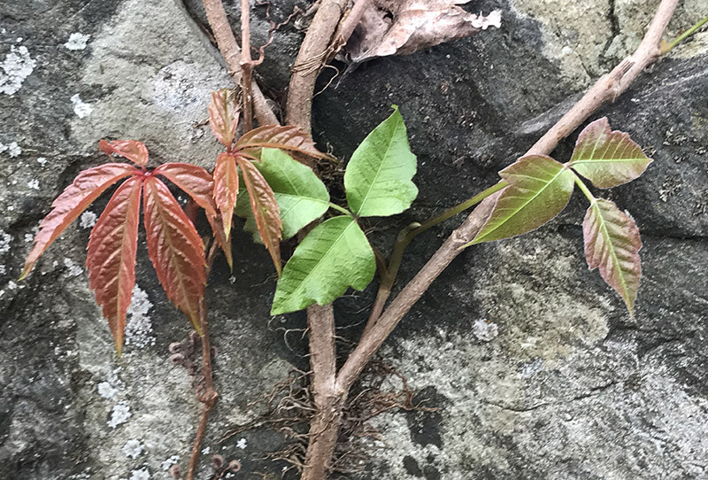
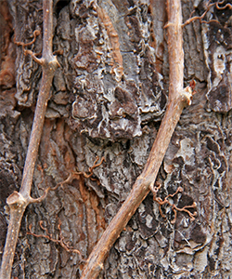
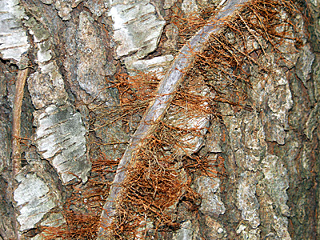
Identify Local Poisonous Plants
Virginia Creeper is sometimes mistaken for poison ivy.
The leaves and vines on the left are Virginia Creeper and those on the right are Poison Ivy.

Slide 34
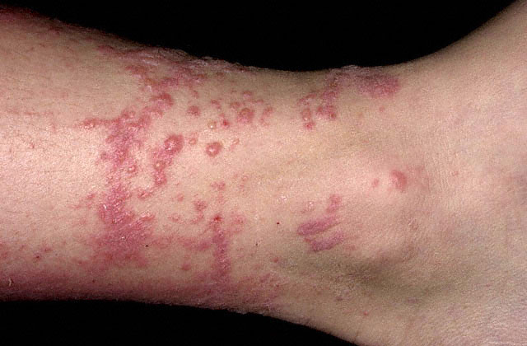
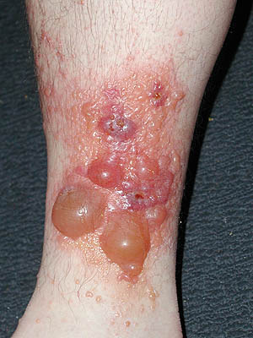
Poison Ivy Rash
Average Case
Severe Case

Slide 35
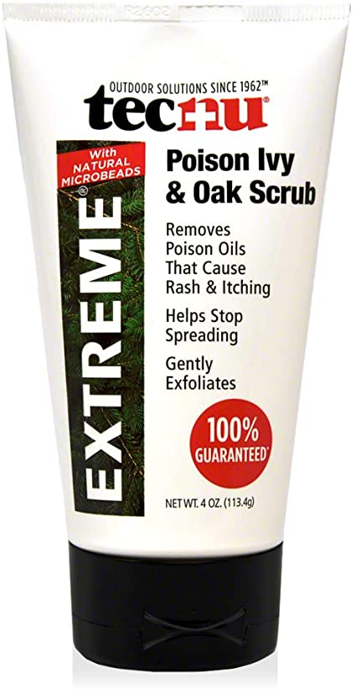
Treating Poison Ivy Exposures
If you are exposed you should quickly (within 10 minutes):
      Clean exposed areas with rubbing alcohol.
      Wash the exposed areas with water only first.
      Then take a shower with soap and warm water.
Tecnu is a poison oak and ivy scrub that removes urushiol.
Unfortunately, if you wait more than 10 minutes, the urushiol will likely stay on your skin and trigger the poison ivy rash.

Slide 36
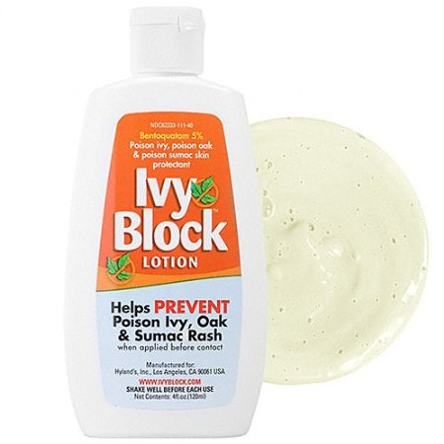
Preventing Poison Ivy
The best way to prevent Poison Ivy is learn to identify it and then avoid it!
You can avoid a poison ivy rash by:
  Wearing long pants and a shirt with long sleeves.
  Boots and gloves when your most at risk, especially when playing in wooden areas, around lakes, or going on hikes.
  Apply Ivy-Block to exposed skin.

Slide 37
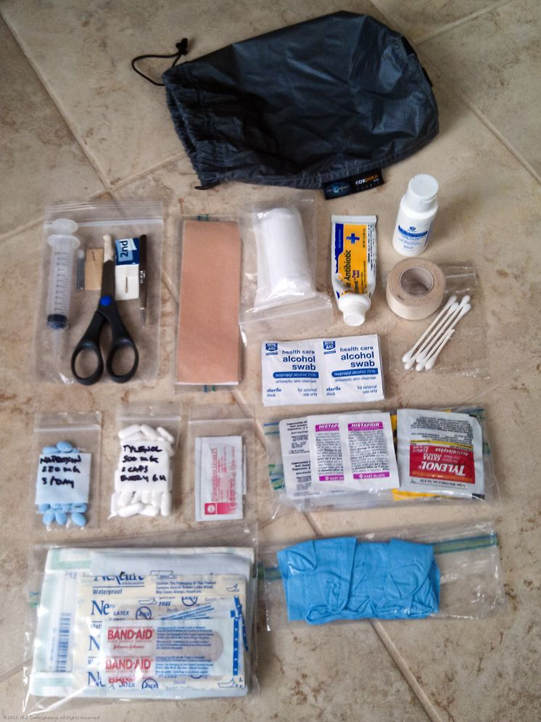
Personal First Aid Kits
Your first aid kit should be suited to the expected use and your training level.
First aid kits need to be convenient to use and in a place where they can be reached easily.

Slide 38
Personal First Aid Kit List
Six adhesive bandages.
Two 3-by-3-inch sterile gauze pads.
One small roll of adhesive tape.
One 3-by-6-inch piece of moleskin.
One small bar of soap or travel-size bottle of hand sanitizer.
One small tube of antibiotic ointment.
One pair of scissors.
One pair of non-latex disposable gloves.

Slide 39
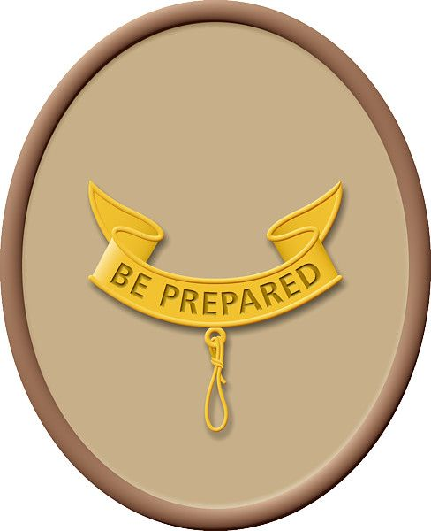
2nd Class First Aid
Requirements
6a. Demonstrate first aid for the following:
  Object in the eye
  Bite of a warm-blooded animal
  Puncture wounds from a splinter, nail, and fishhook
  Serious burns (partial thickness, or second-degree)
  Heat exhaustion
  Shock
  Heatstroke, dehydration, hypothermia, and hyperventilation
6b. Show what to do for hurry cases of stopped breathing, stroke, severe
bleeding, and ingested poisoning.
6c. Tell what you can do while on a campout or hike to prevent or reduce
the occurrence of the injuries listed in Second Class requirements 6a
and 6
6d. Explain what to do in case of accidents that require emergency
response in the home and backcountry. Explain what constitutes an
emergency and what information you will need to provide to a
responder.
6e. Tell how you should respond if you come upon the scene of a vehicular
accident.

Slide 40
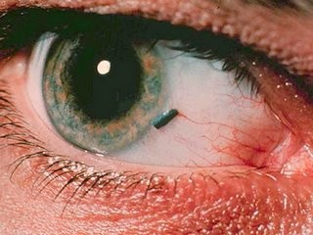
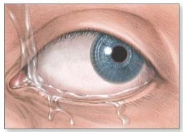
Dirt or Small Particle in Eye
Do not rub eye.
Gently pull upper eyelid out and down over lower eyelid – this sometimes works to remove particle.
Gently flush eye with water from medicine dropper or glass – don’t allow water to run into other eye.
If the particle is visible, carefully try to remove it with a clean cloth or gauze pad.
If victim has any vision problems or pain, cover eye with a sterile dressing and seek medical attention.
Flush the eye with clean water to remove foreign objects.

Slide 41
Animal Bites First aid
Minor Wounds: If the bite barely breaks the skin and there is no danger of rabies, treat it as a minor wound. Wash the wound thoroughly with soap and water. Apply an antibiotic cream to prevent infection and cover the bite with a clean bandage.
Deep wounds. If the animal bite creates a deep puncture of the skin or the skin is badly torn and bleeding, apply pressure with a clean, dry cloth to stop the bleeding and see your doctor.
Infection. If you notice signs of infection, such as swelling, redness, increased pain or oozing, see your doctor immediately.

Slide 42
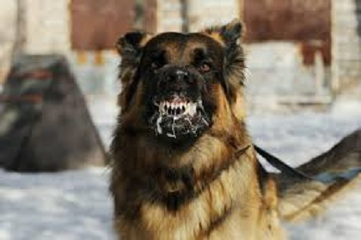

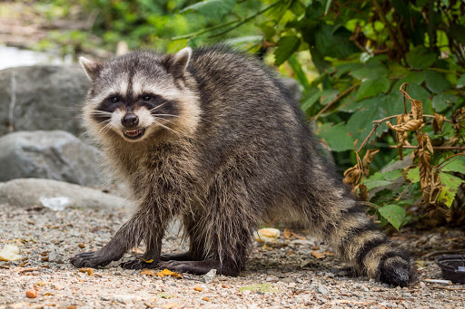
Rabies
A deadly virus spread to people from the saliva of infected animals.
Rabies is usually spread through an animal bite.
  Animals most likely to spread rabies include dogs, bats, coyotes, foxes, skunks, and raccoons.
Symptoms include fever, headache, excess salivation, muscle spasms, paralysis, and mental confusion.
Seek immediate medical attention after a bite or suspected bite.
  There is no specific treatment for rabies.
  Once symptoms appear, it's nearly always fatal.
  A vaccine can prevent infection.

Slide 43
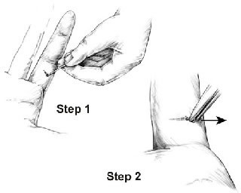
Splinter First Aid
Wash your hands.
Clean tweezers and a needle by pouring antiseptic solution (isopropyl alcohol) over them, and let them dry.
With the tweezers, attempt to pull the splinter out the same direction and angle that it went in the skin.
If the splinter cannot be removed by the tweezers because the tip is not accessible, use the needle to make a small hole above the splinter and/or use the needle to lift the splinter out.
Once the splinter is fully out, wash the area and bandage it with a clean, dry dressing.

Slide 44
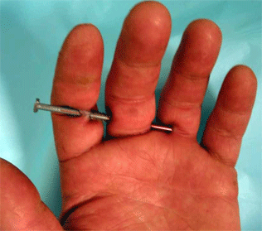
Puncture Wounds
Puncture wound first aid:
  Wash your hands. This helps prevent infection.
  Stop the bleeding by applying gentle pressure with a clean bandage or cloth.
  Clean the wound thoroughly.
  Apply an antibiotic (Neosporin). For the first two days, rewash the area and reapply the antibiotic when you change the dressing.
  Cover the wound with a bandage.
  Change the dressing daily or whenever the bandage becomes wet or dirty.
  Watch for signs of infection and see a doctor if the wound isn't healing or you notice any spreading redness, increasing pain, pus, swelling or fever.

Slide 45
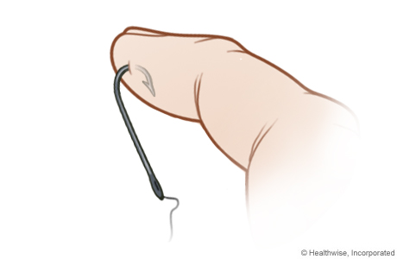
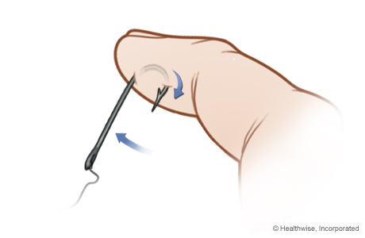
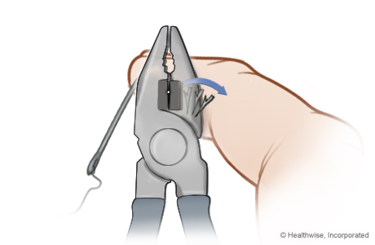

Fishhook First Aid
Advance-and-cut method of fishhook removal
  Push the hook the rest of the way through the skin so the barb comes out through the skin.
  Carefully cut off the barb. (Wire cutters work.)
Remove the rest of the hook by pulling it back out from where it entered the skin.
Be sure to clean the wound to prevent infection.

Slide 46

Burns
The type of burn is not based on the cause of it. Scalding, for example, can cause all three burns, depending on how hot the liquid is and how long it stays in contact with the skin.

Slide 47

How Bad is the Burn?
First-degree burns affect the epidermis and are considered mild compared to other burns.
  Red, non-blistered skin.
Second-degree burns (partial thickness burns) affect the epidermis and the dermis (lower layer of skin). They cause pain, redness, swelling, and blistering.
  Blisters and some thickening of the skin.
Third-degree burns (full thickness burns) go through the dermis and affect deeper tissues.
  Widespread thickness with a white, leathery appearance.

Slide 48

2nd Degree Burns
Symptoms:
  Causes the skin to blister and become extremely red and sore.
  Some blisters pop open, giving the burn a wet or weeping appearance.
Treatment:
  Run the skin under cool water for 15 minutes or longer.
  Take over-the-counter pain medication (acetaminophen or ibuprofen)
  Apply antibiotic cream to blisters.
  Seek emergency medical treatment if the burn affects a widespread area, such as any of the following: Face, hands, buttocks, groin, feet.

Slide 49

Shock

Slide 50

What is Shock?
Not enough blood is getting to the right places around the body.
Can be caused by all kinds of things…both illness and injury.
Untreated – it can lead to death.

Slide 51
Symptoms of Shock
Dizziness
Pale, cool, moist skin
Rapid, shallow breathing
Nausea/vomiting
Extreme thirst
Rapid, weak pulse
Decreased blood pressure
Mental status changes
Restlessness, anxiety
Shock, if untreated, can lead to death.

Slide 52

First Aid for Shock
Place the victim in shock position.
Keep the person warm and comfortable.
Turn the victim’s head to one side if neck injury is not suspected to prevent choking if vomiting occurs.

Slide 53

Dehydration
When the body puts out more liquid than it is taking in.
Ways we lose fluids:
  Sweating.
  Urination.
  Vomiting.
Signs of dehydration:
  Thirst.
  Yellow or dark urine.
  Dry mouth.
  Lightheadedness.
  Nausea and vomiting.
  Dry skin.
  Cease sweating.
Treatment:
  Drink fluids (water, Gatorade).
  Avoid physical activity.
  Get inside air conditioned or cool area.

Slide 54

Heat Emergencies

Slide 55

Heat Exhaustion Symptoms
Heavy sweating
Thirst
Fatigue
Heat cramps
Headache
Dizziness
Nausea
Vomiting

Slide 56

First Aid for Heat Exhaustion
Move victim from heat to rest in a cool place.
Loosen or remove unnecessary clothing.
Give water or a sports drink.
Raise feet 8-12 inches.
Put cool, wet cloths on forehead and body – spray skin with water.
Seek medical care if victim’s condition worsens or does not improve within 30 minutes.

Slide 57

Heatstroke

Slide 58

First Aid for Heat Stroke
Call 911.
Move victim to cool place.
Remove outer clothing.
Cool victim quickly.
Apply cold compresses or spray skin with water.
Put ice bags or cold packs beside neck, armpits, and groin.

Slide 59

Hypothermia
Occurs when body cannot make heat as fast as it loses it.
Internal body temperature drops below 95ºF.
Can occur whenever and wherever a person feels cold, including indoors in poorly heated areas.

Slide 60

First Aid for Hypothermia
Move victim to shelter.
Remove wet clothing and wrap victim in warm covers.
Apply direct body heat.
Re-warm neck, chest, abdomen, and groin first.
Give warm, sweet drinks if conscious.
Monitor breathing, administer CPR.
Get medical help.

Slide 61

Hyperventilation
Abnormal increase in volume of air breathed in and out of the lungs..
Occurs during stressful situations such as infection, bleeding, or heart attack.

Slide 62
Hyperventilation Symptoms
Hyperventilation causes the carbon dioxide level in the blood to decrease.
This reduces blood flow to the brain, which may result in the following symptoms:
  Weakness.
  Tingling in fingers/toes.
  Dizziness/lightheadedness.
  Confusion.
  Agitation.
  Chest pain or fast and pounding heartbeat.
  Dry mouth.
  Nausea.
  Feeling as if you can't catch your breath.
Reaction to the symptoms causes even greater hyperventilation.

Slide 63

Hyperventilation: Treatment
Calm the person down by identifying the source of anxiety and addressing it.
  Hyperventilation is often triggered in wilderness settings by a fear of heights, equipment failures, or by a minor injury that causes anxiety.
Have the person breath into a stuff sack or other bag, covering both the nose and mouth with the bag. This will increase the amount of carbon dioxide in the blood.
If the person does not respond to treatment within 20 minutes, the ailment may be something other than hyperventilation. Other possibilities are asthma, heat exhaustion, and heat stroke.

Slide 64

Stroke
Stroke is a brain injury – blood supply to part of the brain is interrupted.
Headache, dizzy, unusual behavior, passes out, forgets things, slurred speech, weak on one side.
Monitor victim and be prepared to give CPR.
Have victim lie down with head and shoulders slightly raised.

Slide 65

Severe Bleeding First Aid
If possible, before you try to stop severe bleeding, put on synthetic gloves.
  Have the injured person lie down.
  Position the person's head slightly lower than the trunk or elevate the legs.
  This position reduces the risk of fainting by increasing blood flow to the brain.
If possible, elevate the site of bleeding.
Don't probe the wound or attempt to clean it at this point. Your principal concern is to stop the bleeding.

Slide 66
Severe Bleeding First Aid
Apply pressure directly on the wound. Use a sterile bandage, clean cloth or even a piece of clothing.
  If nothing else is available, use your hand.
Maintain pressure until the bleeding stops. Hold continuous pressure for at least 20 minutes without looking to see if the bleeding has stopped.
  You can maintain pressure by binding the wound tightly with a bandage (or even a piece of clean clothing) and adhesive tape.
Don't remove the gauze or bandage. If the bleeding continues and seeps through the gauze or other material you are holding on the wound, add more absorbent material on top of it.

Slide 67

Direct Pressure
Apply pressure directly to the wound.
56

Slide 68

Severe Bleeding First Aid
If the bleeding doesn't stop with direct pressure, apply pressure to the artery delivering blood to the area of the wound.
  Pressure points of the arm are on the inside of the arm just above the elbow and just below the armpit.
  Pressure points of the leg are just behind the knee and in the groin.
  Squeeze the main artery in these areas against the bone keeping your fingers flat.
  With your other hand, continue to exert pressure on the wound itself.
Immobilize the injured body part once the bleeding has stopped.
Leave the bandages in place and get the injured person to the emergency room as soon as possible.

Slide 69

Poisoning
If someone is poisoned, there could be nausea, vomiting, abdominal cramps, drowsiness, dizziness.
Determine (if you can) what was swallowed, when, and how much.
Call 911 or Poison Control Center (1-800-222-1222).
Do not induce vomiting.

Slide 70

Carbon Monoxide Poisoning
Invisible, odorless, and tasteless—and very lethal.
May be present from motor vehicle exhaust, a faulty furnace, fires, some camping heaters.
Exposure to large amounts causes an immediate poisoning reaction.
Get victim away from source.

Slide 71

Carbon Monoxide Poisoning

Slide 72

First Aid for Drug Overdose
Put unresponsive victim in recovery position, check breathing, and call 911.
For responsive victim ensure it is safe to approach.
If behavior is erratic or violent, call 911 and stay away.
Try to find out what drug is involved.

Slide 73
Your Steps at an Emergency
Decide to be helpful and prepared before an accident happens.
Recognize the emergency.
Call EMS if required.
Assess the victim.
Provide care.
Everyone of any age can render assistance. Your actions in the first few minutes will make a difference.

Slide 74

Is It Safe?
Take care of yourself, then your helpers, finally the victim.
Is the scene safe?
What caused this?
Is there anything here that can hurt me?

Slide 75

Call 911 When Appropriate
Call 911 immediately for a life threatening injury or illness.
Do not try to transport a critical victim to the emergency room yourself.

Slide 76

Calling for Help in a Boating Emergency
This is a special situation!
Carry a whistle to attract attention.
Wave to other boats or shore if in trouble.
Cell phones may not work in remote areas or on the water – don’t depend on them.

Slide 77

Calling for Help in a Camping Emergency
This is a special situation!
At campsites check out cell phone coverage as soon as you arrive.
Always have a plan for how to get to the nearest phone.
Be able to describe the location and directions to get there.

Slide 78

1st Class First Aid
Requirements
7a. Demonstrate bandages for a sprained ankle and for injuries on
the head, the upper arm, and the collarbone.
7b. By yourself and with a partner, show how to:
  Transport a person from a smoke-filled room.
  Transport for at least 25 yards a person with a sprained ankle.
7c. Tell the five most common signals of a heart attack. Explain the
steps (procedures) in cardiopulmonary resuscitation (CPR).
7d. Tell what utility services exist in your home or meeting place.
Describe potential hazards associated with these utilities and
tell how to respond in emergency situations.
7e. Develop an emergency action plan for your home that includes
what to do in case of fire, storm, power outage, and water
outage.
7f. Explain how to obtain potable water in an emergency.

Slide 79

First Aid for Sprains
Immobilize area in position found.
Put ice or cold pack on area.
Wrap joint with compression bandage.
Use soft splint to immobilize and support joint.
Seek medical attention if appropriate.

Slide 80



Wrapping a Sprain with an Elastic Bandage
1. Hold end in place for first turn of bandage
2. Continue with overlapping turns (overlap by about 3/4 of previous turn
3. Fasten end of bandage with clips, tape, or safety pins
88

Slide 81



Elastic bandage will work at any joint on the limbs.
Elbow
Knee
Ankle
89

Slide 82

Bandaging

Slide 83

Bandaging Techniques
There are different techniques for different types of bandages and locations of the wound.
Even small wounds need cleaning and bandaging.

Slide 84

Bandaids – Use Them Correctly!

Slide 85

Technique for Roller Bandage
Use gauze pad if you have one.
Hold end in place for first turn of bandage.
Unroll gauze as you bandage (don’t unroll first.)

Slide 86

Technique for Roller Bandage
Cover the cut with a crisscross pattern (figure 8).
Make a loop in final turn to tie off.

Slide 87

Technique for Roller Bandage
Use the ends of the bandage to tie a bow knot over the cut.

Slide 88



Technique for a Triangular Bandage
Triangular bandages can also be a dressing.
It is more than just a sling!

Slide 89


Technique for a Self-Adherent Bandage
Use a gauze pad underneath to cover the wound.

Slide 90


Head Bandage
Triangular bandage applied to head.
Cravat bandage applied to head.

Slide 91


Collarbone Injuries
Collarbone injuries require immobilization until a doctor can be seen.
Sling keeps arm from moving.
A good sling keeps the hand higher than the elbow.
Tie the knot on the side of the neck for comfort.

Slide 92
When to Move an Injured Person
Typically, don't move an injured person.
  You can do more damage moving them, so in most cases wait for the paramedics.
You may have to move the victim if:
  They are in immediate danger, such as near a fire, rising water, or with severe weather approaching.
  When help is not on the way, and the patient cannot be treated for their problem at their present location.
Before deciding whether to transport, a patient must be stabilized as much as possible.
  This means assuring open airways, controlling bleeding, splinting orthopedic injuries, treating hypothermia, and more.

Slide 93

Shoulder Drag
Support the head.
Use for short distances.

Slide 94

Ankle Drag
Use for short distances.

Slide 95

Blanket Drag
Support victim’s head.
Use for longer distances.

Slide 96

Packstrap Carry
For victim who cannot be dragged safely.

Slide 97



Fireman’s Carry
Note: Wrist lock.

Slide 98

Piggyback Carry
For a lighter victim.

Slide 99

One Person Walking Assist
Responsive victim who can walk with help.

Slide 100

Two Person Walking Assist
Responsive victim who can walk with help.

Slide 101

Two-Handed Seat Carry
Use with two rescuers.

Slide 102


Improvised Stretcher
To move a victim onto a stretcher, position the stretcher next to the victim.
The victim should be on their back with their arms at their side.
Support the head in alignment with the spine throughout.
Place the victims arms across their chest.
Logroll the patient on their side. Slide the stretcher underneath.
Roll the patient back onto the stretcher.

Slide 103

What Is a Heart Attack?
Sudden reduced blood flow to the heart muscle due to blockage of an artery.
Signs and symptoms vary considerably.
May have no signs or symptoms before collapsing suddenly or victim may have mild symptoms that come and go for hours or days prior to the attack.

Slide 104

Signs and Symptoms

Slide 105

CPR for Adults and Children

Slide 106
CPR Protocols
The A‐B‐C order for CPR (Airway‐Breathing‐Circulation) has been changed to C‐A‐B (Compressions‐Airway‐ Breathing).
This is based on medical research that shows CPR is more effective if done first and promptly.
Volunteers will no longer check for a pulse or Look‐Listen‐Feel for breathing.

Slide 107
New CPR Protocols
Are you OK? – Check responsiveness.
Unresponsive? Assess breathing by looking at the victim (DO NOT open airway yet by tilting head…DO NOT Look-Listen-Feel).
Not breathing? Call 911 and send for AED if available.
Start with 30 compressions and then two breaths.
Continue with CPR – 30 compressions, then 2 breaths.

Slide 108

CPR Technique
Position on their back.
If victim appears to be not breathing or is gasping call 911, get AED, and start CPR.
Use a barrier device if you have one.

Slide 109

CPR Technique
30 compressions

Slide 110

CPR Technique
Open the airway
Use the head-tilt-chin-lift technique

Slide 111

Rescue Breathing
Two breaths

Slide 112

Give 30 compressions at a speed of 100 per minute
Then give 2 breaths

Slide 113
Not Sure About Rescue Breathing?
If you don’t remember how to do breaths then just do continuous chest compressions.
If you don’t want to do breaths then just do continuous compressions.

Slide 114

Check Airway
If victim may have been choking, check for object before giving rescue breaths. If you see obstruction, remove it.
Then continue CPR.

Slide 115

Continue CPR until…
Victim moves.
AED arrives and is ready to use.
Help arrives.
You are too tired to continue.

Slide 116

What Happens if I Don’t Remember?
If you don’t exactly remember the steps of CPR, do the best you can!
If you can’t figure out the breaths, then perform continuous chest compressions.
With a heart in trouble, it is always better to try some kind of CPR than do nothing.
Always call for help quickly.

Slide 117
Utility Hazards in the Home
Gas Leaks.
  Recognizing a natural gas leak is simple—if you hear a hissing sound and smell rotten eggs, or just notice the smell, there's probably a leak.
    First, leave the area immediately.
    Then call 911 and your local utility.
Electrical Shorts & Surges.
  Never attempt to modify or adjust electrical utilities yourself. Instead, utilize a qualified electrician.
Water Leaks.
  Leaks can rot wood, crumble drywall, and cause mold to grow, which has been linked to an unpleasant array of health issues for residents.
  Turn off the water supply until repair can take place. The faster the source of the leak is identified and neutralized, the less chance there is for long-term or serious damage.
Carbon Monoxide.
  An invisible, odorless gas that can be deadly if left undetected.
  Common sources of carbon monoxide include malfunctioning furnaces, kerosene heaters, gas and wood stoves, fireplaces, and motor vehicle engines.
  CO and smoke detectors are a must.

Slide 118
Emergency Action Plan for Home
An emergency action plan helps protect yourself and your family in the event of an emergency.
Being prepared can reduce fear, anxiety, and losses that accompany disasters.
Home Evacuation and Floor Plan
  Draw a floor plan of your house.
  Include two ways out of every room, including windows.
  Mark the locations of the first aid kit, fire extinguisher, and tornado shelter.
Plan to have 3 meeting places for your family in case of an emergency:
  Directly outside of the house in case of fire.
  Within the neighborhood – walking distance, in case your street was blocked off for something like a gas leak.
  Outside of the neighborhood – biking or driving distance in case it wasn’t save to be in your town because of some sort of natural disaster such as a tornado.

Slide 119
Emergency Action Plan for Home
Contact information
  Your family may not be together when disaster strikes, so it is important to plan in advance how you will contact one another.
  Make an individual card for each person in your family.
Emergency Kits
  Since you never know when an emergency will occur, it is important to be prepared at all times. You can do this by having certain supplies on hand for different types of emergencies. Create a list of items you should have for the following types of kits:
    First Aid Kit – supplies you would need for a medical emergency.
    To Go Kit – supplies you would need if you were told to leave your home not knowing when you would be able to return.
    Shelter in Place Kit – supplies you would need if you were unable to leave your home for at least 3 days and your home may or may not have working utilities.

Slide 120

Home Evacuation Floor Plan Example.

Slide 121
Emergency Action Plan
Storm Emergency:
Make a storm emergency kit that includes supplies you might need while you're sheltering from a hurricane or tornado, or if you lose power for several days after a major storm.
It should include things like cash, non-perishable foods, water, a first-aid kit, and more.
Water Outage
Buy water – Always stock up on water in your 72-hour emergency kit to ensure you have enough safe drinking water during the outage.
You can also fill your bath tub with water that can be used when flushing your toilet.

Slide 122
Emergency Action Plan
Power Outage
Plan for batteries and other alternatives to meet your needs when the power goes out.
Keep freezers and refrigerators closed.
Maintain food supplies that do not require refrigeration.
Generators, camp stoves, or charcoal grills should always be used outdoors and at least 20 feet away from windows.
Never use a gas stovetop or oven to heat your home.
Check on your neighbors.
Go to a community location with power if heat or cold is extreme.
Turn off or disconnect appliances, equipment, or electronics.
Power may return with momentary “surges” or “spikes” that can cause damage.

Slide 123



How to Obtain Potable Water in an Emergency
Boiling
  Boiling is sufficient to kill pathogens.
  If water is cloudy, let it settle and filter it through a clean cloth or coffee filter.
  Bring water to a rolling boil for at least one minute.
Disinfectants
Filters
Distillation

